Slide 1
QUARTIZE 🐐

Slide 2
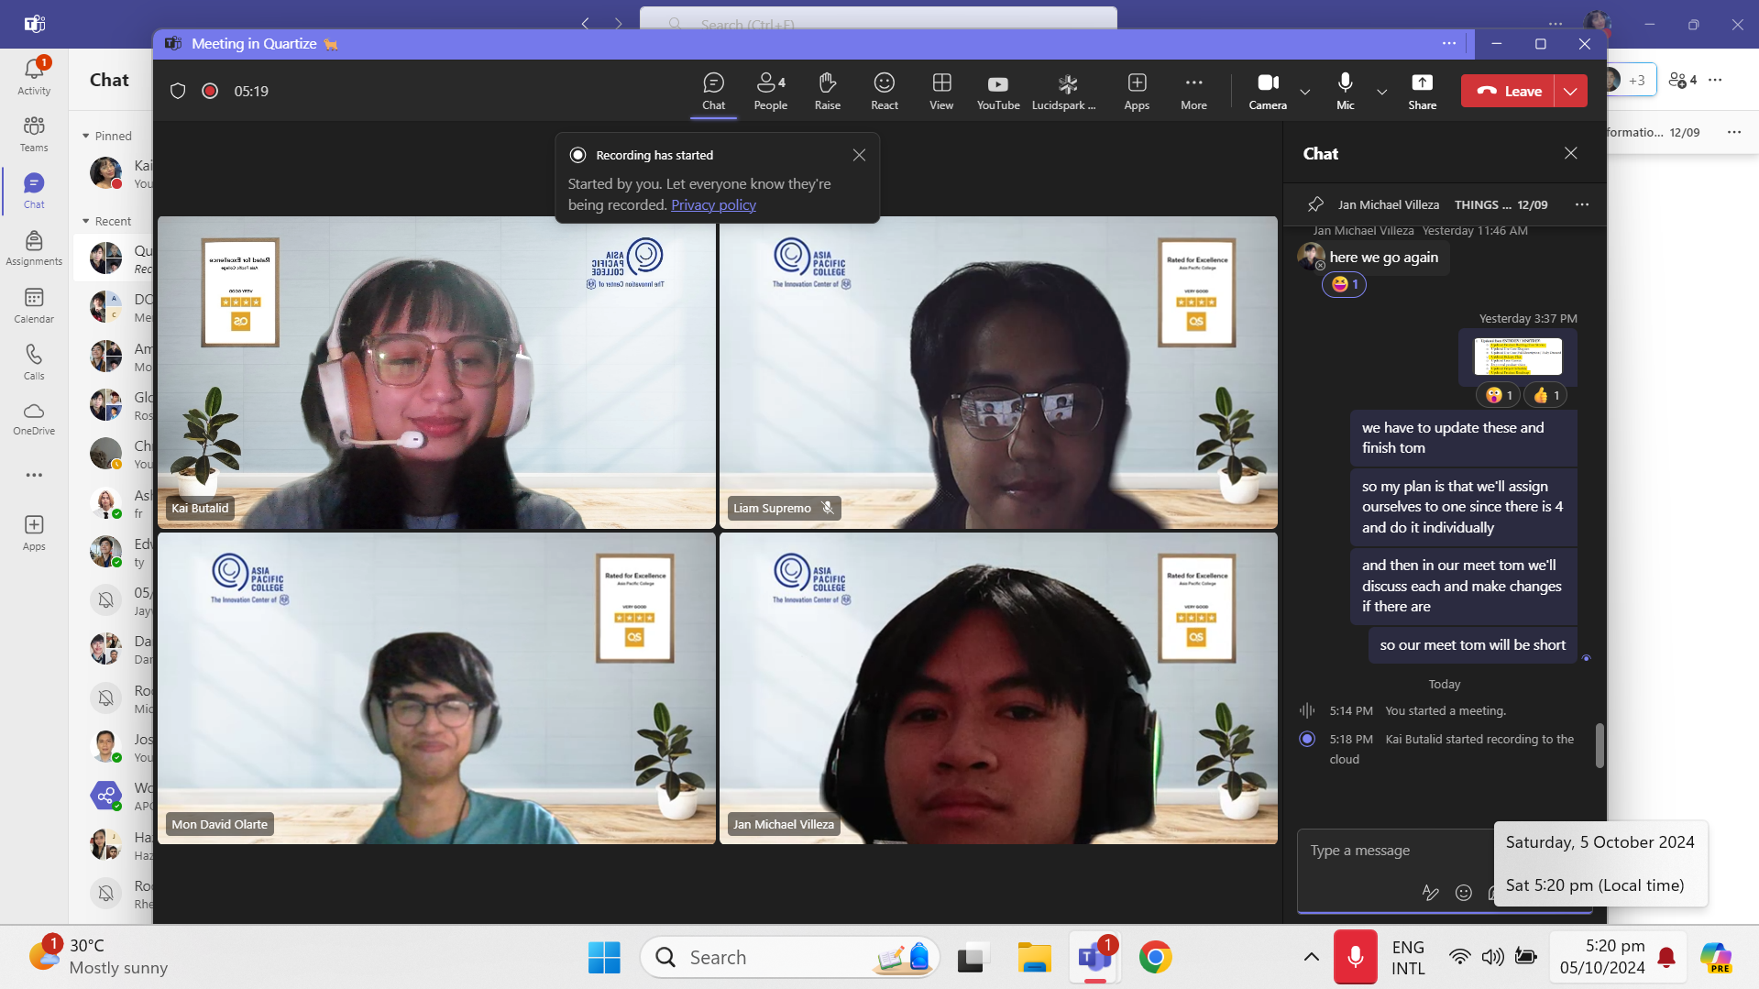
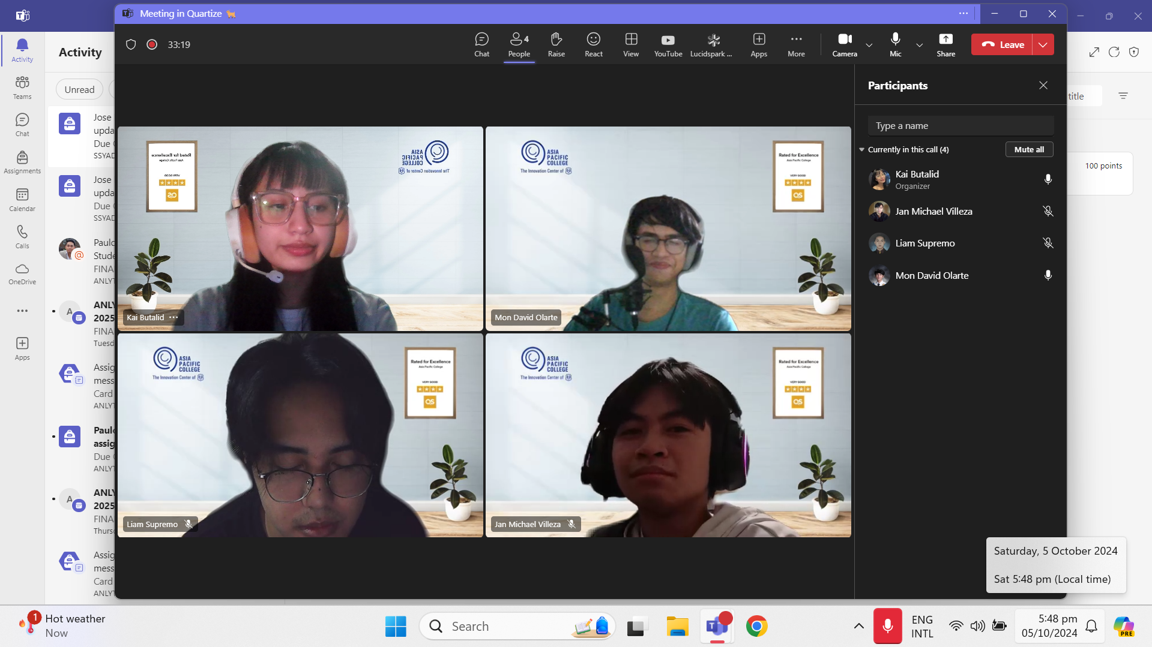
QUARTIZE 🐐
Kai
Liam
Mon
JM

Slide 3
QUARTIZE 🐐
Kai
Liam
Mon
JM
Advisor: Sir Jose Eugenio L. Quesada

Slide 4
O4P
Online Portal Pursuing Purposeful Play

Slide 5
Objectives
Decrease the amount of time it takes to complete the scheduling process by at least 40%.
Enhance patient experience with therapy sessions through the implementation of AR technology.
Increase the volume of patients after deploying the proposed system for a year by 20%.

Slide 6
FOR | The staff at Therapro Therapy Clinic
WHO | are looking for a more efficient and innovative system
THAT | will streamline processes and allow the clinic to hold online therapy
UNLIKE | the clinic’s current system
OUR PRODUCT | will offer a flexible environment and efficient automated processes
Online
Portal

Slide 7
Comments Matrix

Slide 8
 | Comments
Rhea-Luz Valbuena | Consistent naming conventions - members in UCD but Patient and Parent/Guardian in DFD.
 | Do not connect actors to data stores and vice versa. Always have a process in between.
 | Process must always have at least one input and output in DFD.
Jo Anne M. de la Cuesta | Inconsistent naming conventions in diagrams.
Primary Actor | User (Patient, Parent/Guardian, Therapist, Admin)
Include use cases: | User Registration (UC 01A) and User Login (UC 01B)
Preconditions: | The System is online and accessible
Postconditions: | Success: The user is successfully authenticated, either by creating a new account or logging into an existing account. Failure: The user receives an appropriate error message (e.g., invalid credentials, duplicate email) and is not granted access to the system.
Triggers: | ·The user is accessing the system and either needs to create an account (register) or log in to an existing account.
Special Requirements | ·The system should support secure authentication (e.g., password encryption, multi-factor authentication if needed). ·The system must handle forgotten passwords and email verification efficiently to avoid authentication delays.
Assumptions | ·Users have access to a valid email address and internet access to complete the registration process and or login.

Slide 9
Use Case Diagram

Slide 10
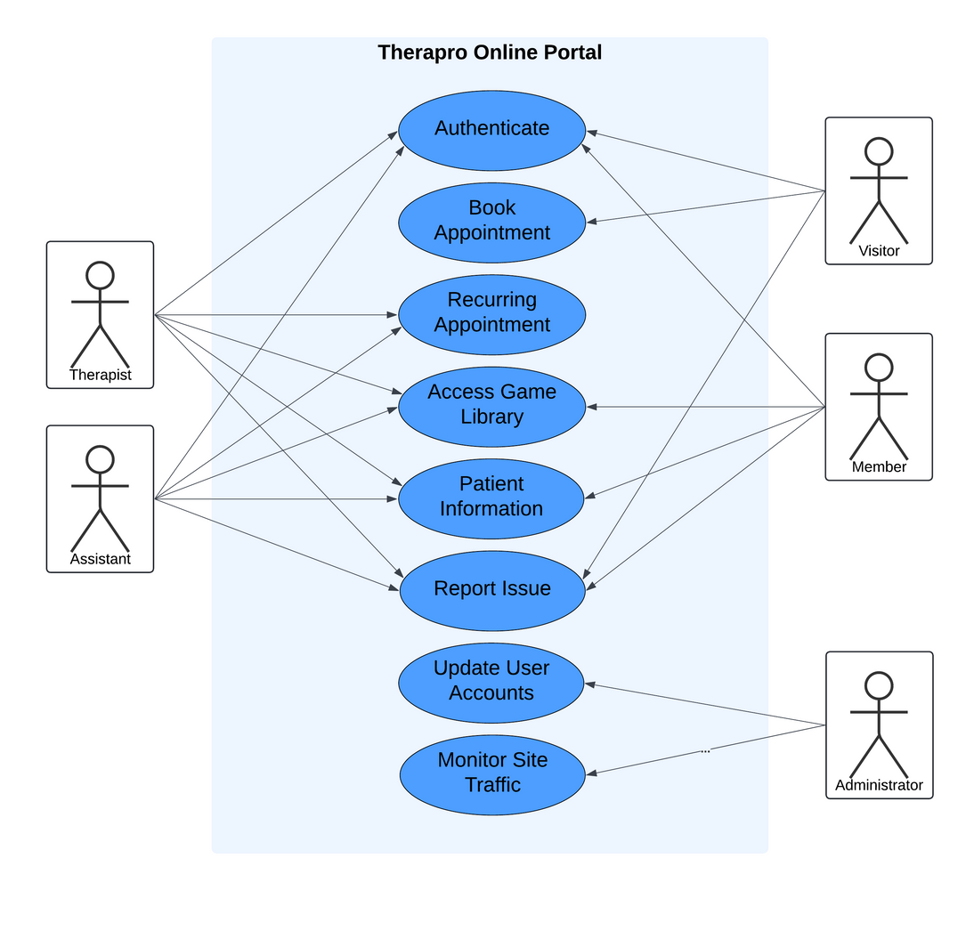
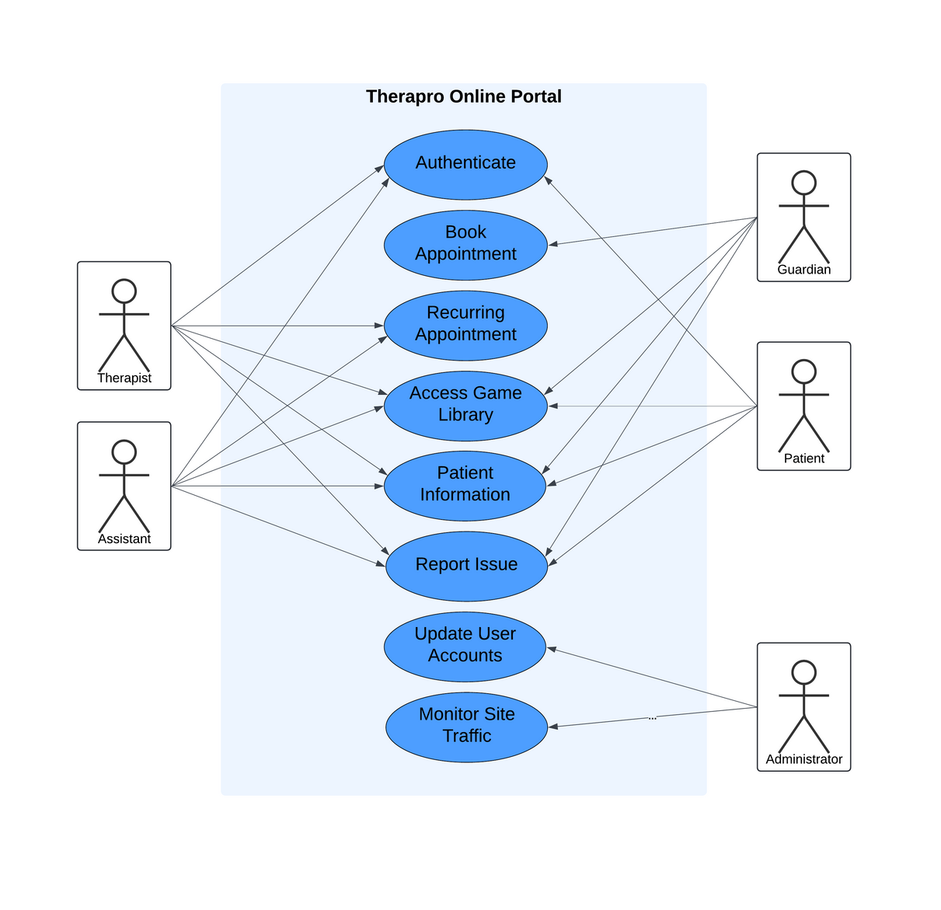
Midterms
Updated
Primary Actor | User (Patient, Parent/Guardian, Therapist, Admin)
Include use cases: | User Registration (UC 01A) and User Login (UC 01B)
Preconditions: | The System is online and accessible
Postconditions: | Success: The user is successfully authenticated, either by creating a new account or logging into an existing account. Failure: The user receives an appropriate error message (e.g., invalid credentials, duplicate email) and is not granted access to the system.
Triggers: | ·The user is accessing the system and either needs to create an account (register) or log in to an existing account.
Special Requirements | ·The system should support secure authentication (e.g., password encryption, multi-factor authentication if needed). ·The system must handle forgotten passwords and email verification efficiently to avoid authentication delays.
Assumptions | ·Users have access to a valid email address and internet access to complete the registration process and or login.

Slide 11
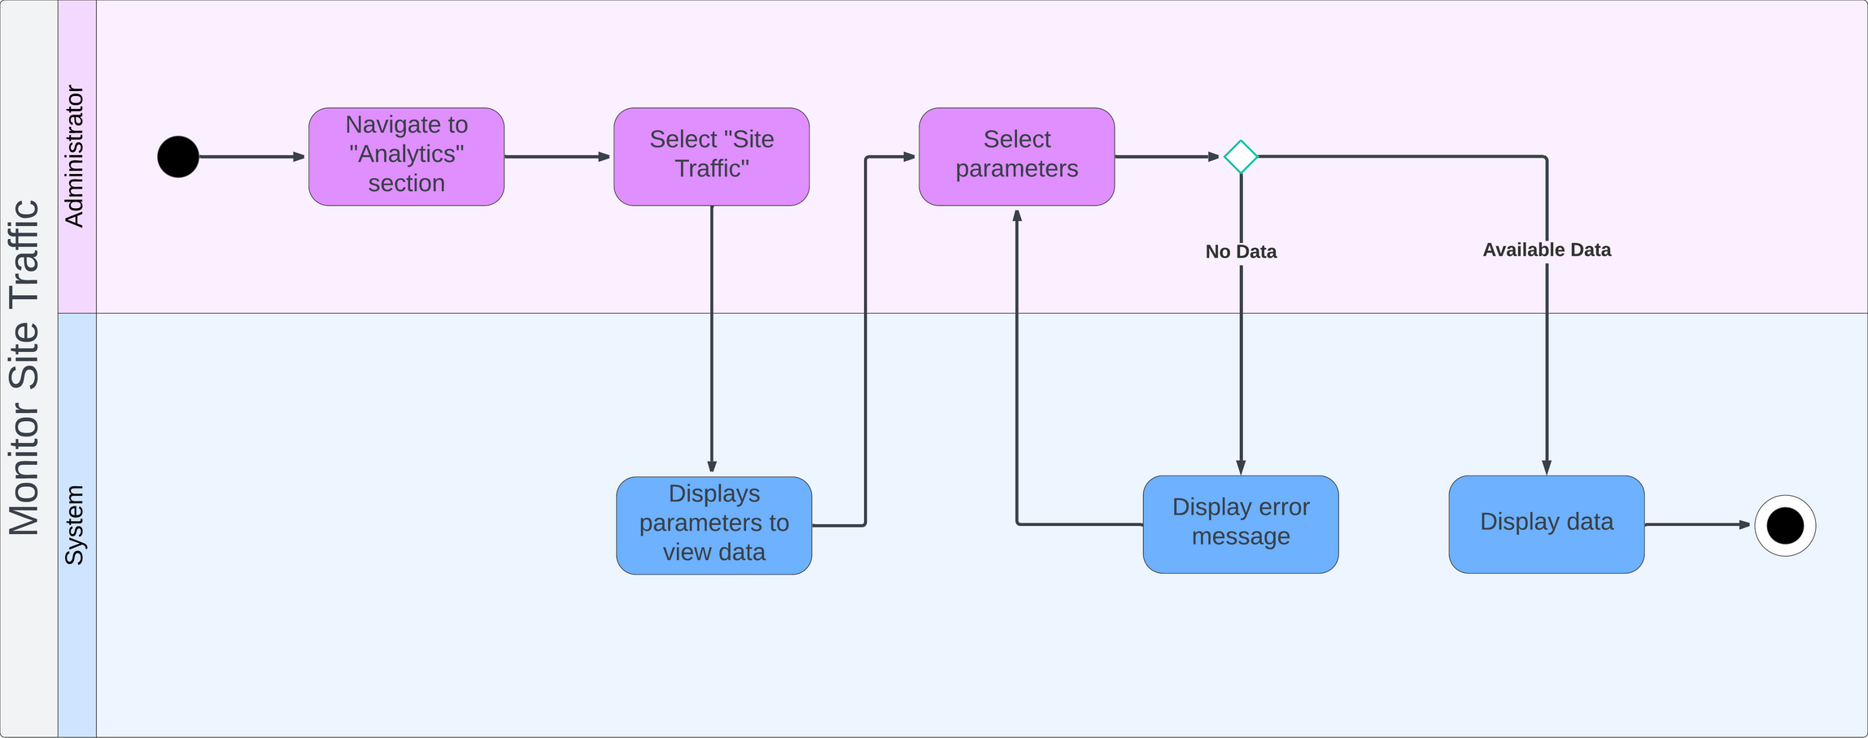
MONITOR SITE TRAFFIC
Data Flow Diagrams

Slide 12
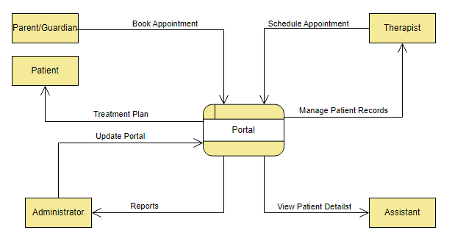
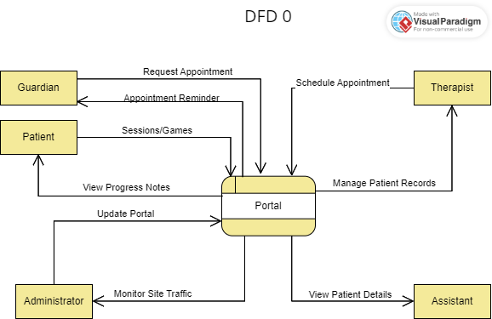
LEVEL 0
Midterms
Updated
Primary Actor | User (Patient, Parent/Guardian, Therapist, Admin)
Include use cases: | User Registration (UC 01A) and User Login (UC 01B)
Preconditions: | The System is online and accessible
Postconditions: | Success: The user is successfully authenticated, either by creating a new account or logging into an existing account. Failure: The user receives an appropriate error message (e.g., invalid credentials, duplicate email) and is not granted access to the system.
Triggers: | ·The user is accessing the system and either needs to create an account (register) or log in to an existing account.
Special Requirements | ·The system should support secure authentication (e.g., password encryption, multi-factor authentication if needed). ·The system must handle forgotten passwords and email verification efficiently to avoid authentication delays.
Assumptions | ·Users have access to a valid email address and internet access to complete the registration process and or login.

Slide 13
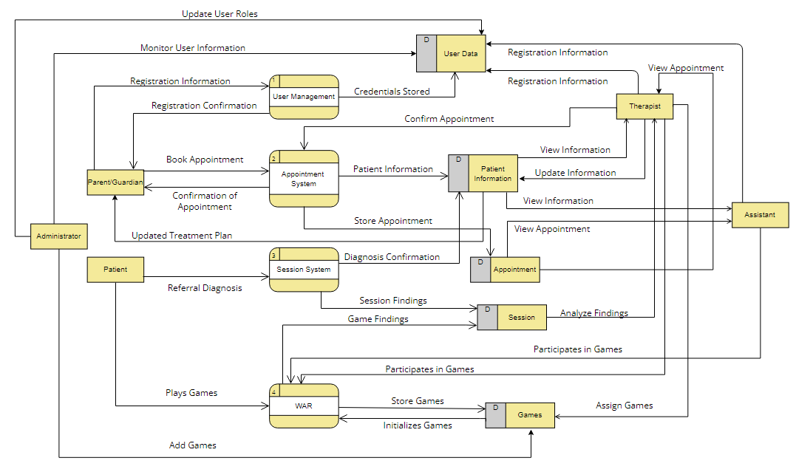
LEVEL 1
Midterms

Slide 14
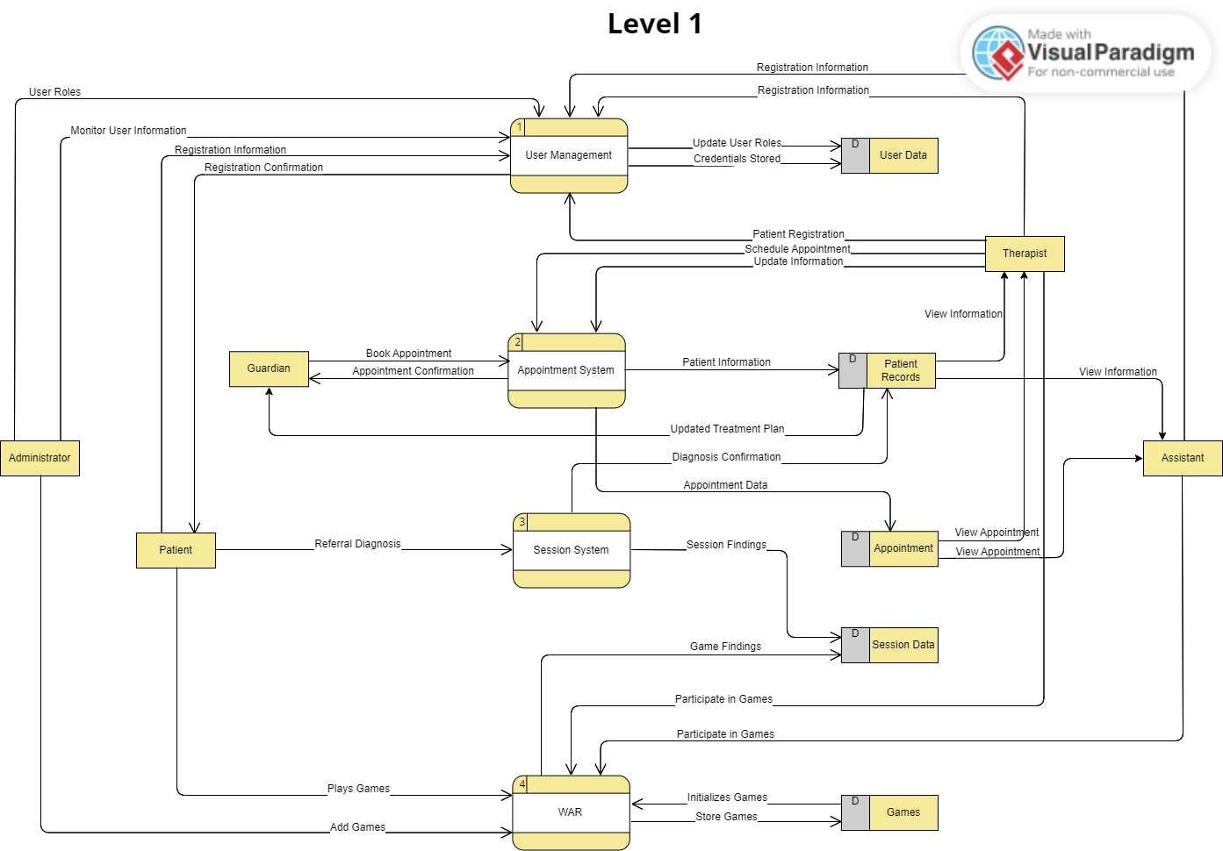
LEVEL 1
Updated

Slide 15
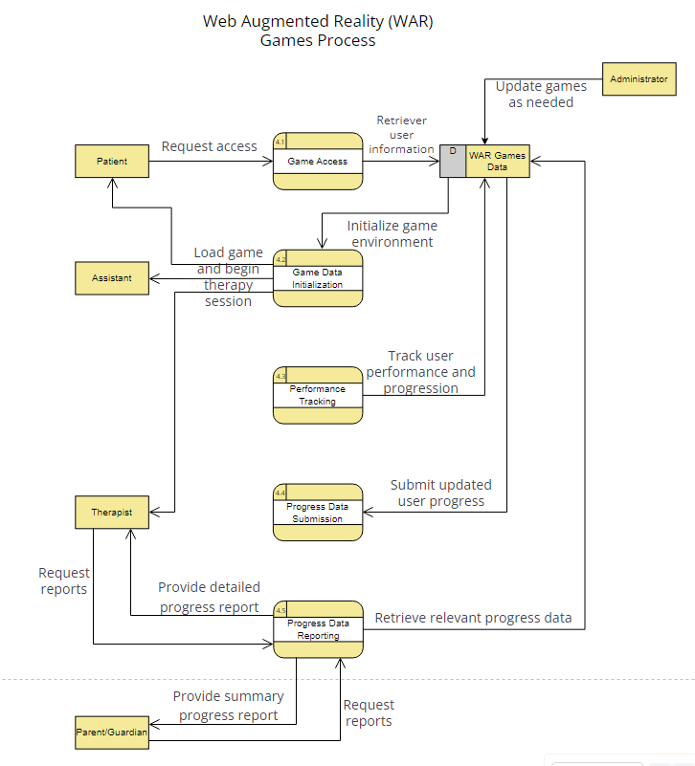
LEVEL 2
Midterms

Slide 16
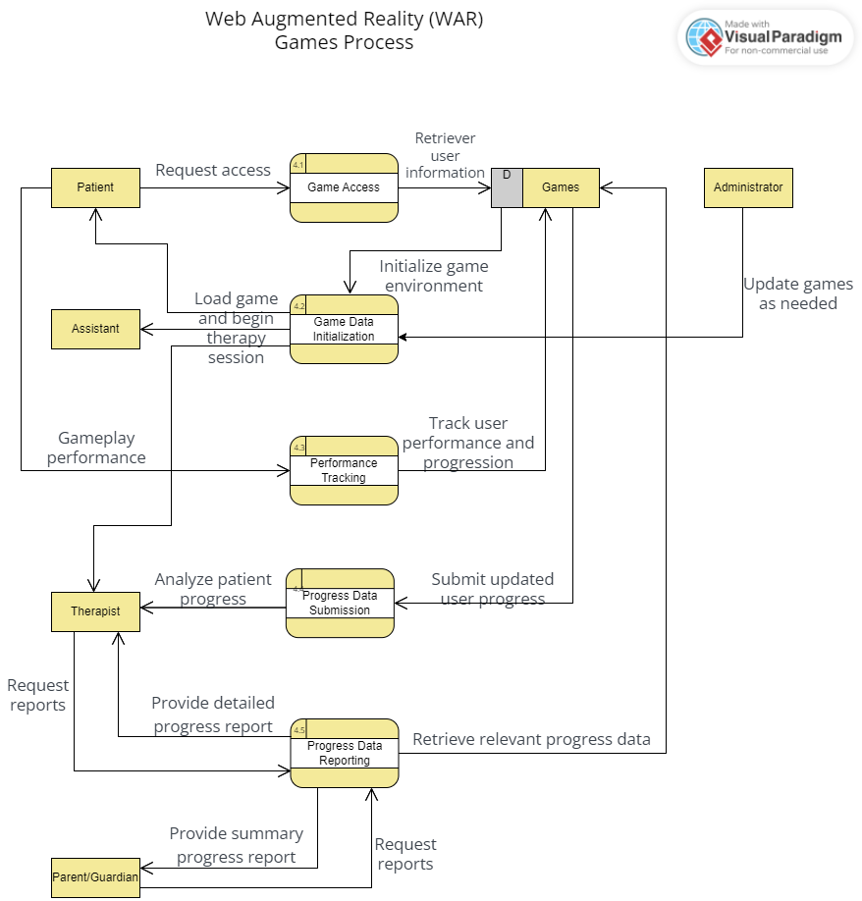
LEVEL 2
Updated

Slide 17
Entity Relationship Diagram

Slide 18
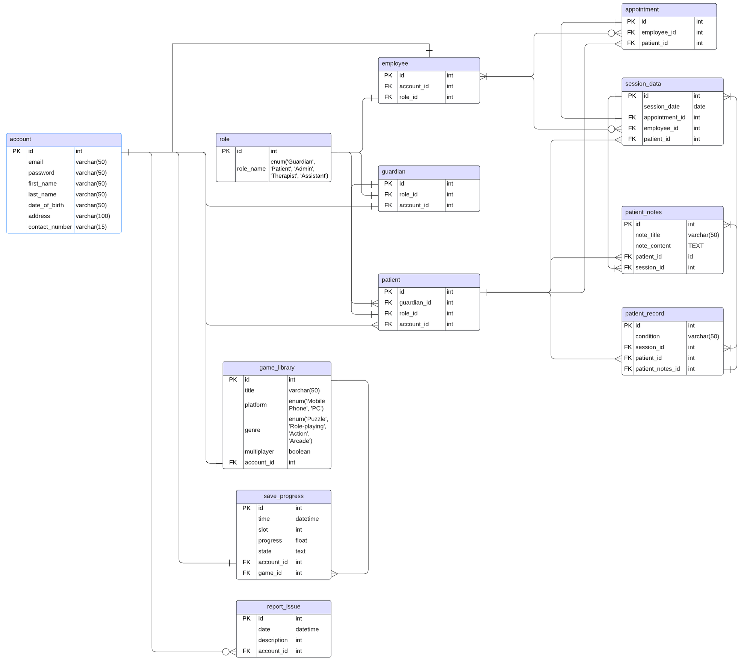

Slide 20
Github Collaboration

Slide 21
Demonstration

Slide 22
Kai Butalid
Liam Supremo
Mon Olarte
JM Villeza
ERD
Documentation
Front-end development
ERD
Documentation
Game development
ERD
Website and portal routing
Model creations
User authentication and RBAC
ERD
Front-end development

Slide 23
Any Questions?

